Slide 1
APT 1040A: Introduction to web design and applications
JavaScript: Introduction to Scripting

Slide 2
Topics Covered
Writing simple JavaScript programs.
Using input and output statements
Basic memory concepts.
Arithmetic operators.
Decision-making statements.
Relational and equality operators.

Slide 3
Introduction
JavaScript scripting language
  Client-side scripting enhances functionality and appearance
    Makes pages more dynamic and interactive
    Pages can produce immediate response without contacting a server
    Customization is possible on the basis of users’ explicit and implicit input
    Browser has to have a built-in (JavaScript) interpreter
  Foundation for complex server-side scripting

Slide 4
JavaScript: Object-Based Language
There are three object categories in JavaScript: Native Objects, Host Objects, and User-Defined Objects.
  Native objects: defined by JavaScript.
    String, Number, Array, Image, Date, Math, etc.
  Host objects : supplied and always available to JavaScript by the browser environment.
    window, document, forms, etc.
  User-defined objects : defined by the author/programmer
Initially, we will use host objects created by the browser and their methods and properties

Slide 5
Scripting
Two approaches to client side scripting:
  Inline scripting
    Written in the <body> section of a document
  JavaScript code embedded in the <head> section

Slide 6
Scripting
<script> tag
    Indicate that the text is part of a script
    type attribute
      Specifies the type of file and the scripting language use:
        Value: “text/javascript”
      IE and Netscape use JavaScript as default scripting language
writeln method of the document object
      Write a line in the document and position the cursor in the next line
      Does not affect the actual rendering of the HTML document
        What is being written by JavaScript is the set of html instructions that in turn determine the rendering of the html document

Slide 7
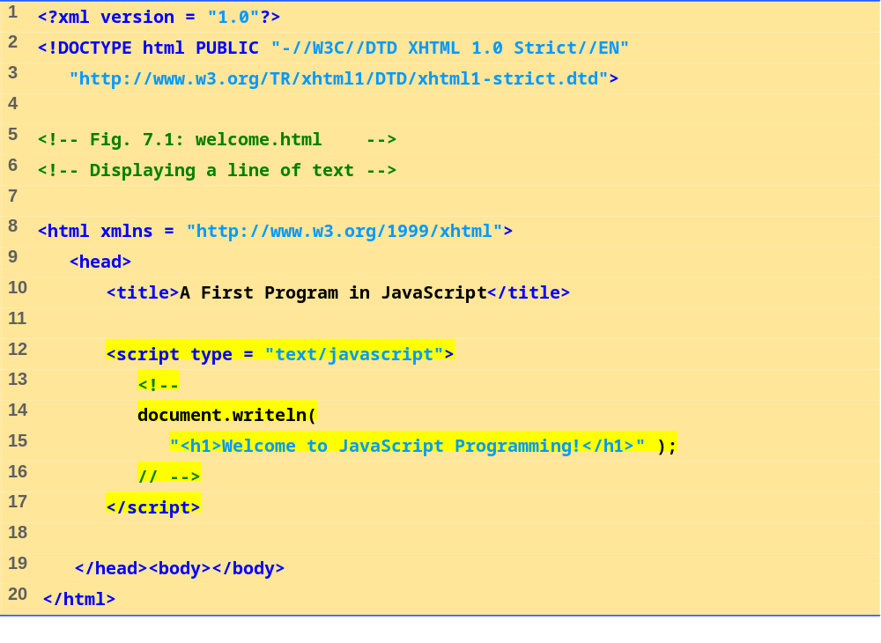
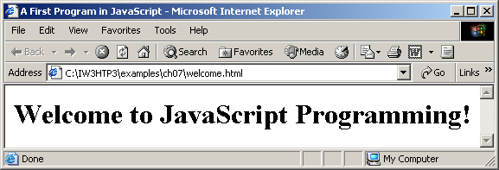
welcome.html
(1 of 1)
←HTML comment tags will
←result in skipping of the script ←by those browsers that do not ←support scripting

Slide 8
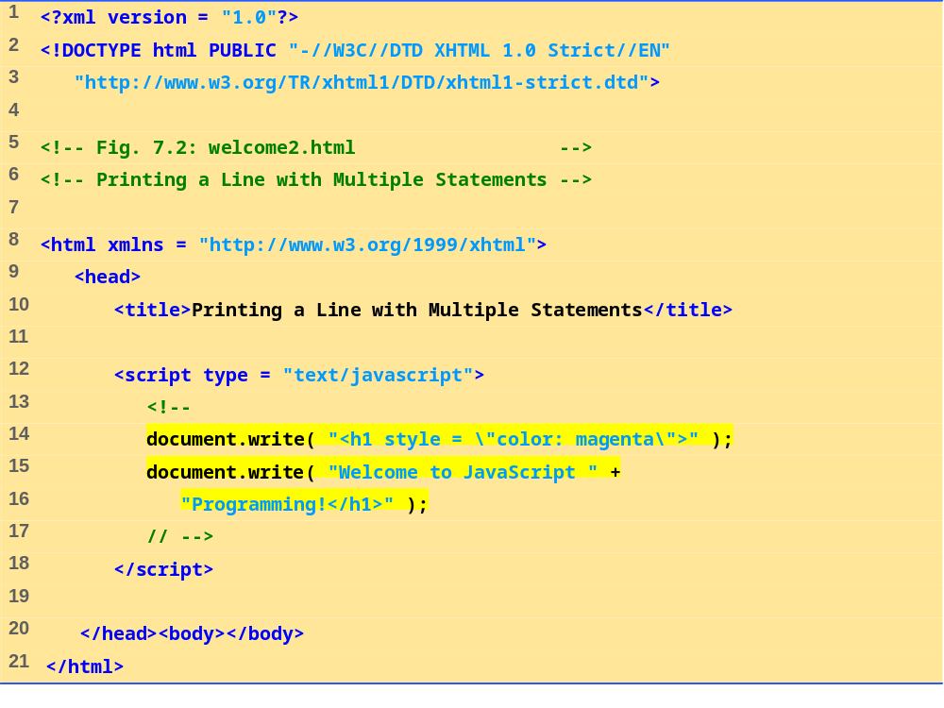
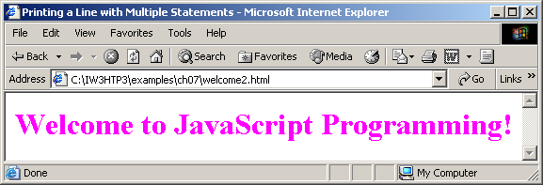
welcome2.html
(1 of 1)
←Escape character in combination
with quotation mark: \” will result
in insertion of a quotation mark in
the string that is actually written
by JavaScript

Slide 9
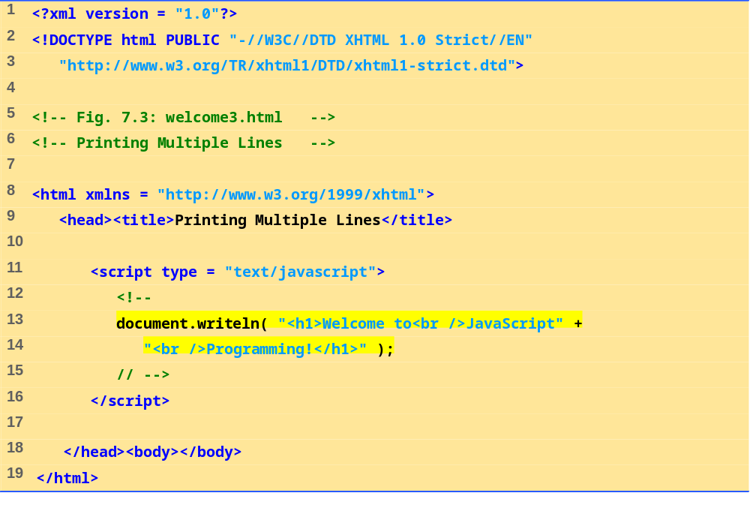
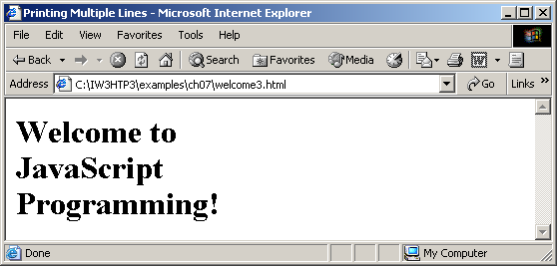
welcome3.html
1 of 1
←New line of the html document
in a browser is determined by an
html <br /> element

Slide 10
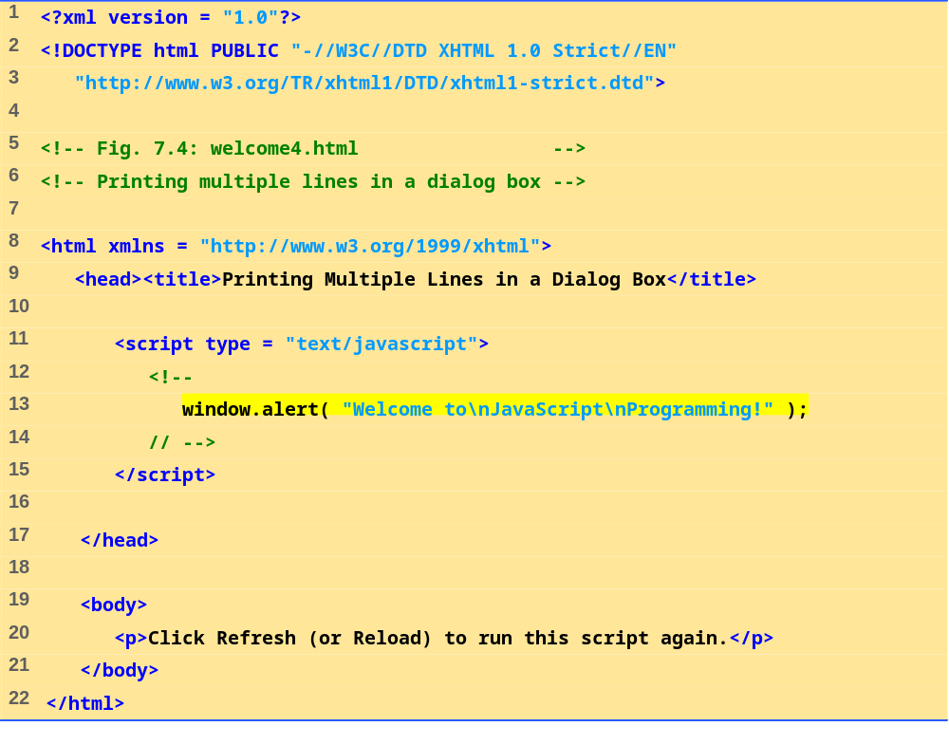
welcome4.html
1 of 1
    ←alert method of the window
    object displays a Dialog box

Slide 11
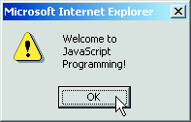
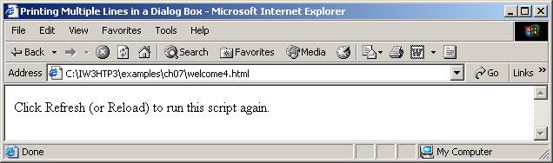

Slide 12
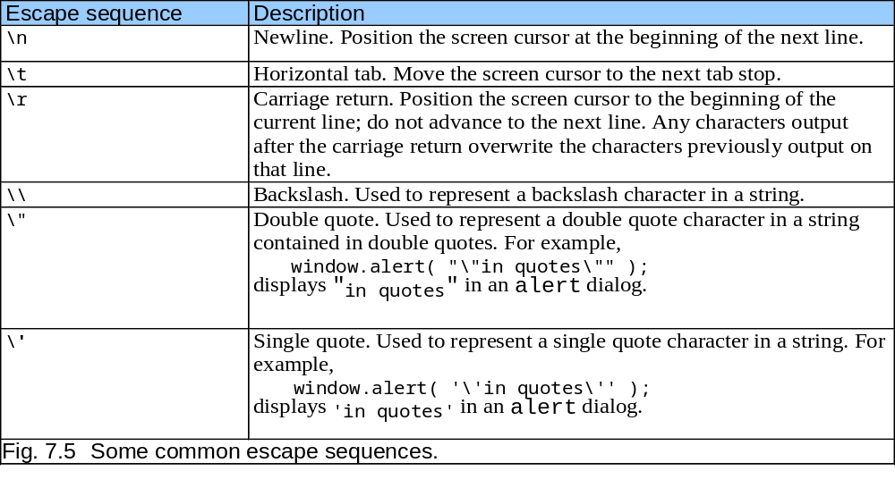
Common Escape Sequences

Slide 13
Dynamic Pages
A script can adapt the content based on explicit input from the user or other information
  System clock: Time of day
  Hidden input
  Cookies
User input can be collected by invoking the prompt method of a window object
  This will display a dialog box that prompts user for input

Slide 14
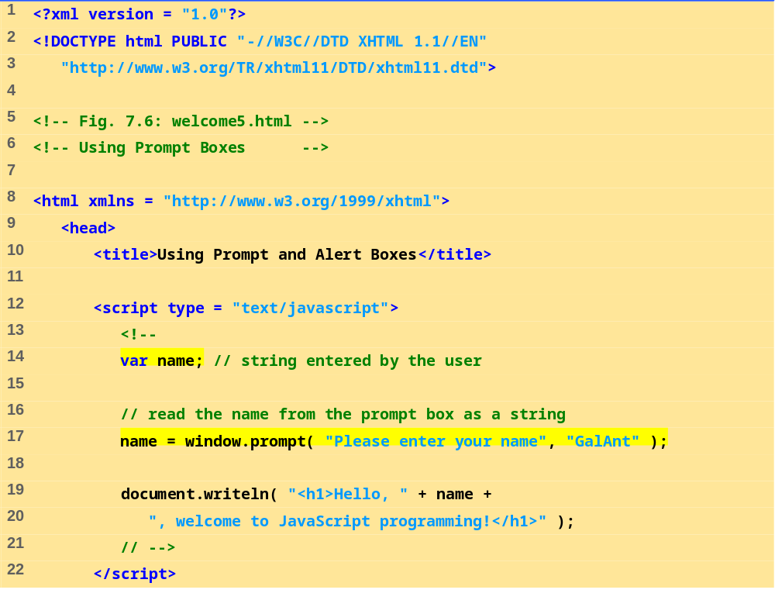
welcome5.html
(1 of 2)
JavaScript is a loosely typed language. Variables take on any data type depending on the value assigned.
←
← Value returned by the prompt method of the window object is assigned to the variable name
“+” symbol can be used for text concatenation as well as arithmetic operator

Slide 15
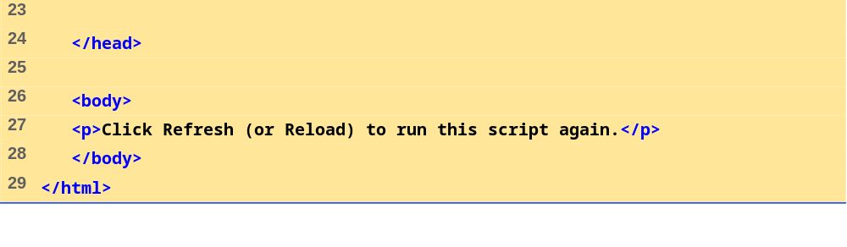
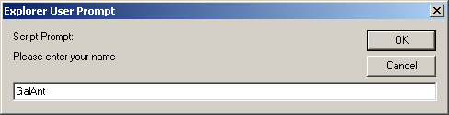
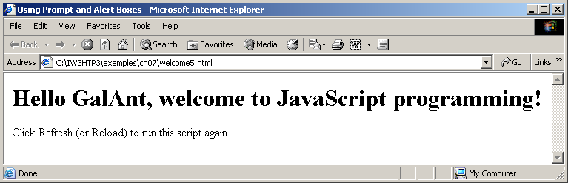

Slide 16
When the user clicks OK, the value typed by the user is returned to the program as a string.
This is the prompt
to the user.
This is the text field in which the user types the value.
If the user clicks Cancel, the null value will be returned to the program and no value will be assigned to the variable.
This is the default value that appears when the dialog opens.
Fig. 7.7 Prompt dialog displayed by the window object’s prompt method.

Slide 17
Simple Script Example: Adding Integers
The values of numbers to be added are obtained as user inputs colleted through the window.prompt method
parseInt
  Converts its string argument to an integer
  What happens if the conversion is not done?
    See example on our web site
NaN (not a number): value returned if non-numerical values are passed to the paresInt method

Slide 18
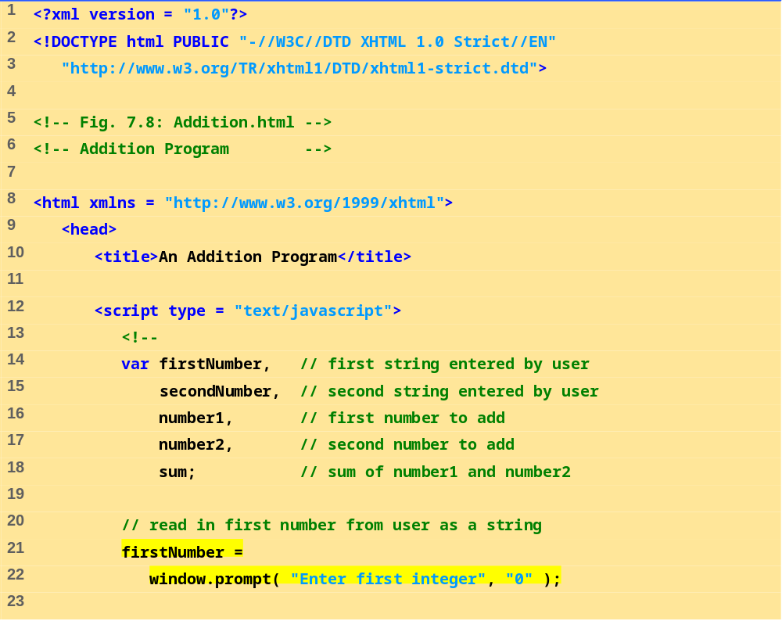
Addition.html
(1 of 2)

Slide 19
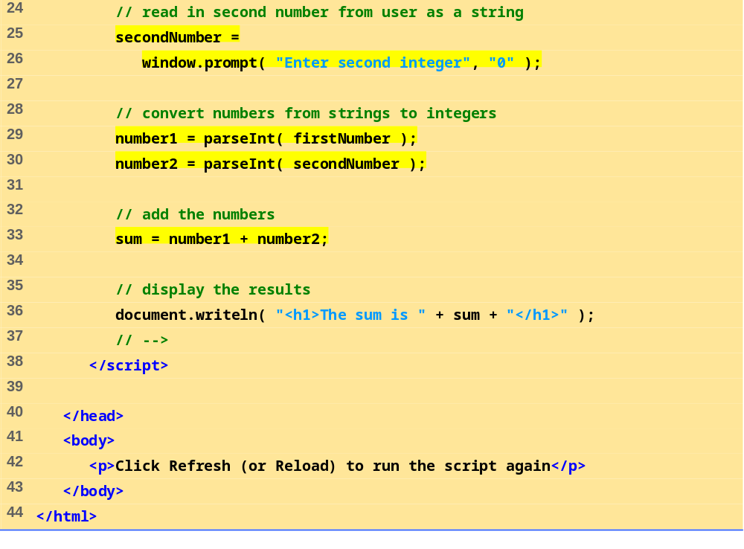
Addition.html
(2 of 2)

Slide 20
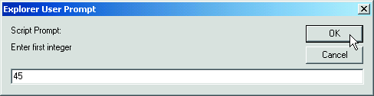
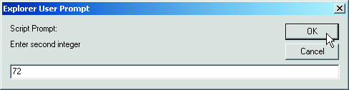
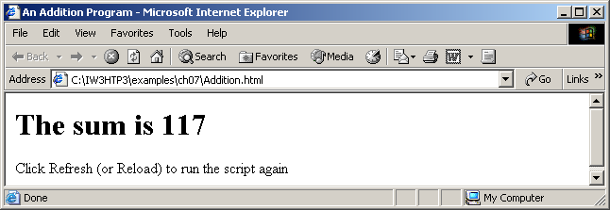

Slide 21
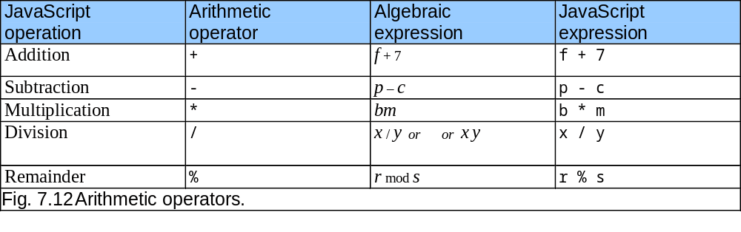
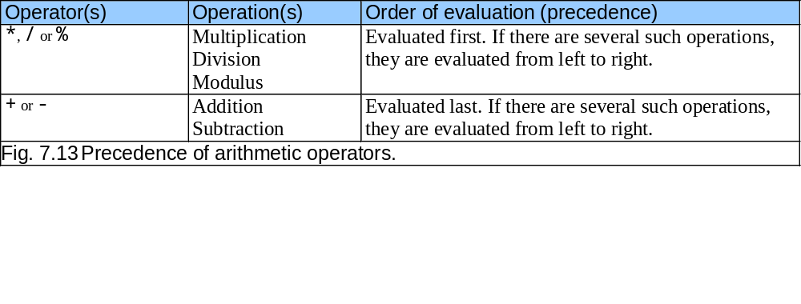
Arithmetic Operators and order of evaluation
Always use parentheses to ensure desired order of evaluation: (a + b) / 6

Slide 22
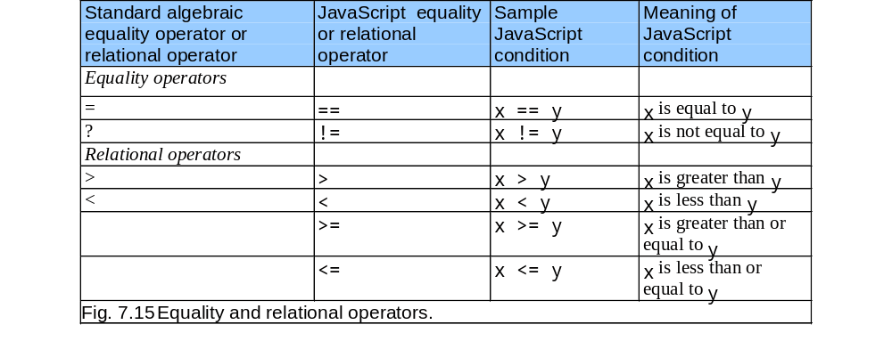
Relational (Inequality and Equality) Operators
≥
≤
Do NOT confuse relational equality operator “==“ with an assignment operator “=“

Slide 23
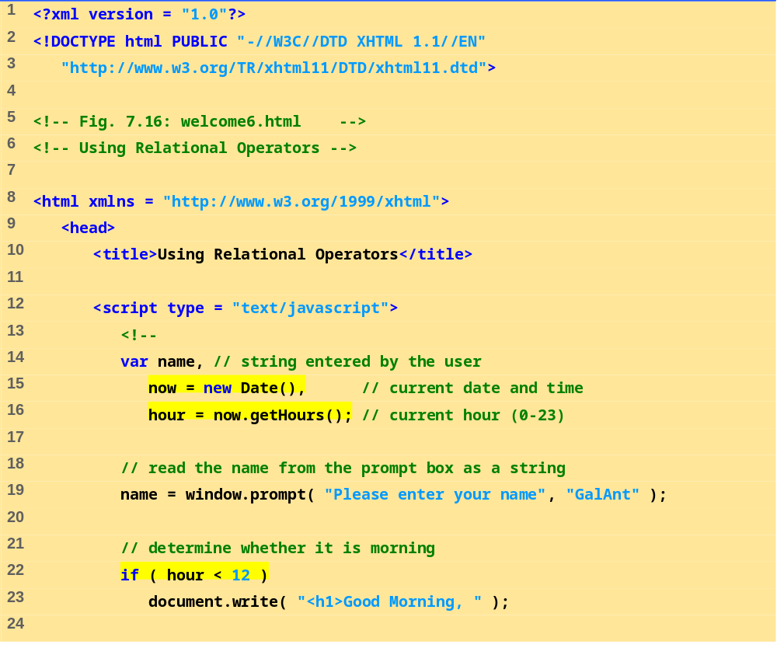
welcome6.html
(1 of 3)
“now” is a new instance of JavaScript native object Date. It can invoke all the methods of that object class
Note that conversion to integer
type was not needed when the
value was returned by the getHours method

Slide 24
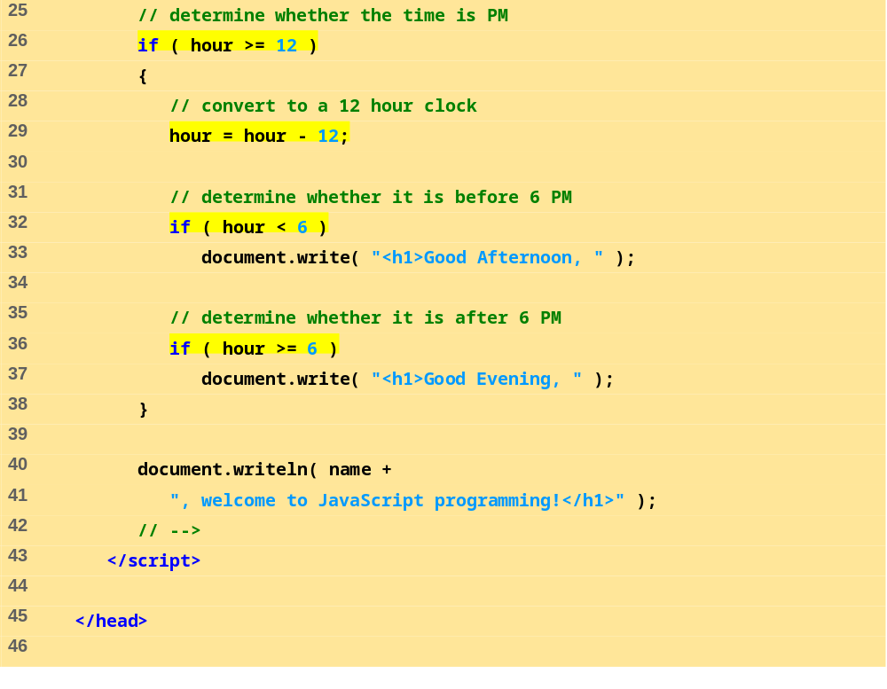
welcome6.html
(2 of 3)

Slide 25
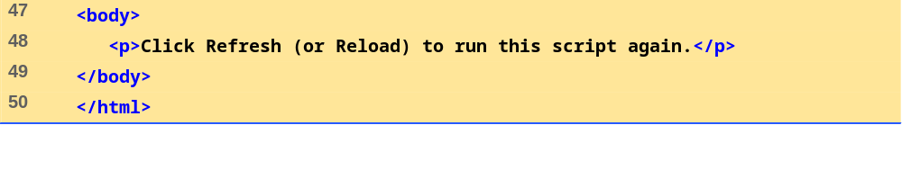
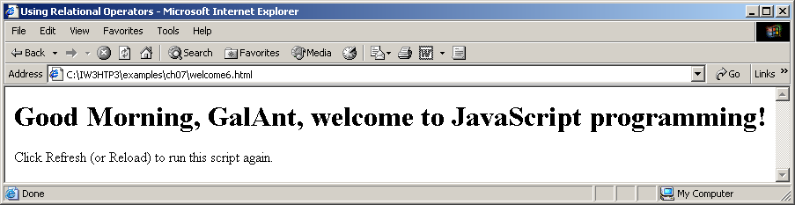
welcome6.html
(3 of 3)

Slide 26
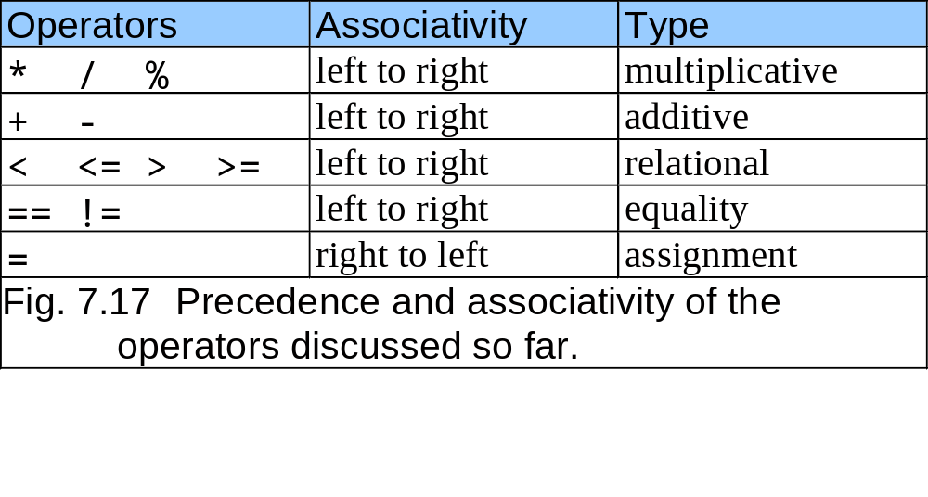
Order of Precedence for the Basic Operators
highest
lowest

